Slide 1
CSE 521 - Operating Systems Fall 2026
Lecture - 12 Process Synchronization - II
Created by Dr. Tevfik Koşar
Presented by Dr. Nine

Slide 2

Roadmap
Recap: Solutions for Mutual Exclusion
Semaphores
Classic Problems of Synchronization
Bounded Buffer Problem
Readers and Writers Problem
Dining-Philosophers Problem
Monitors
Conditional Variables
Sleeping Barber Problem

Slide 3
Synchronization Hardware
Many systems provide hardware support for critical section code
Uniprocessors – could disable interrupts
Currently running code would execute without preemption
Generally too inefficient on multiprocessor systems
Operating systems using this not broadly scalable
Modern machines provide special atomic hardware instructions
Atomic = non-interruptable
Either test memory word and set value
Or swap contents of two memory words

Slide 4
Semaphores
Synchronization tool for critical section problem
Semaphore S – integer variable
Can only be accessed through two standard operations:
wait() and signal()
(or P() and V())
(in dutch: Proberen/test ; Verhogen/increase)
Classical implementation (using busy-waiting)
wait (S) {
while S <= 0
; // no-op
S--;
}
signal (S) {
S++;
}

Slide 5
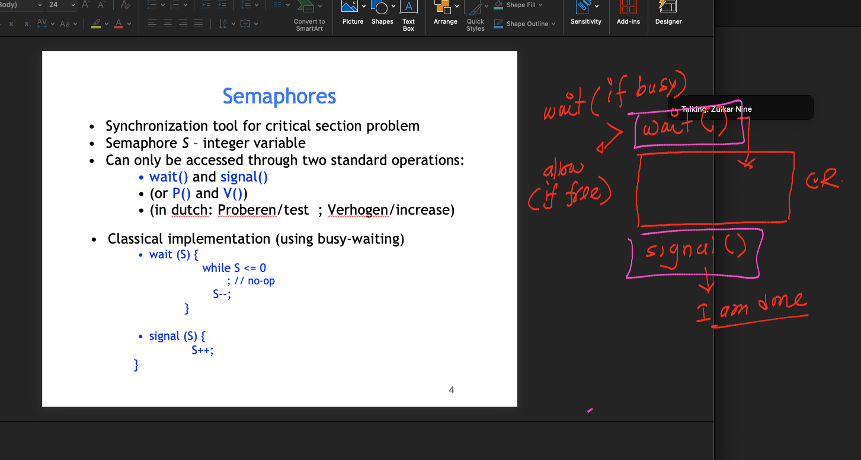

Slide 6
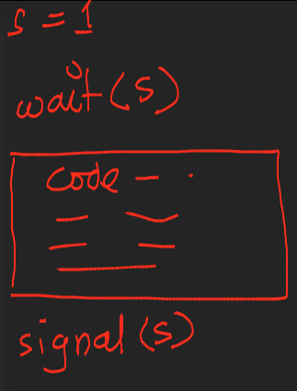

Slide 7
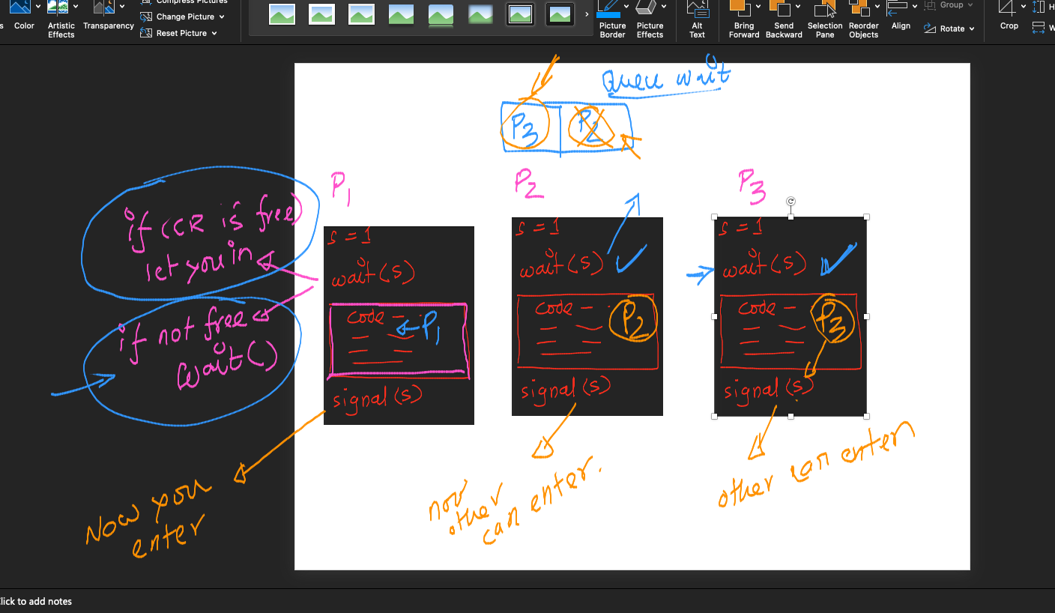

Slide 8
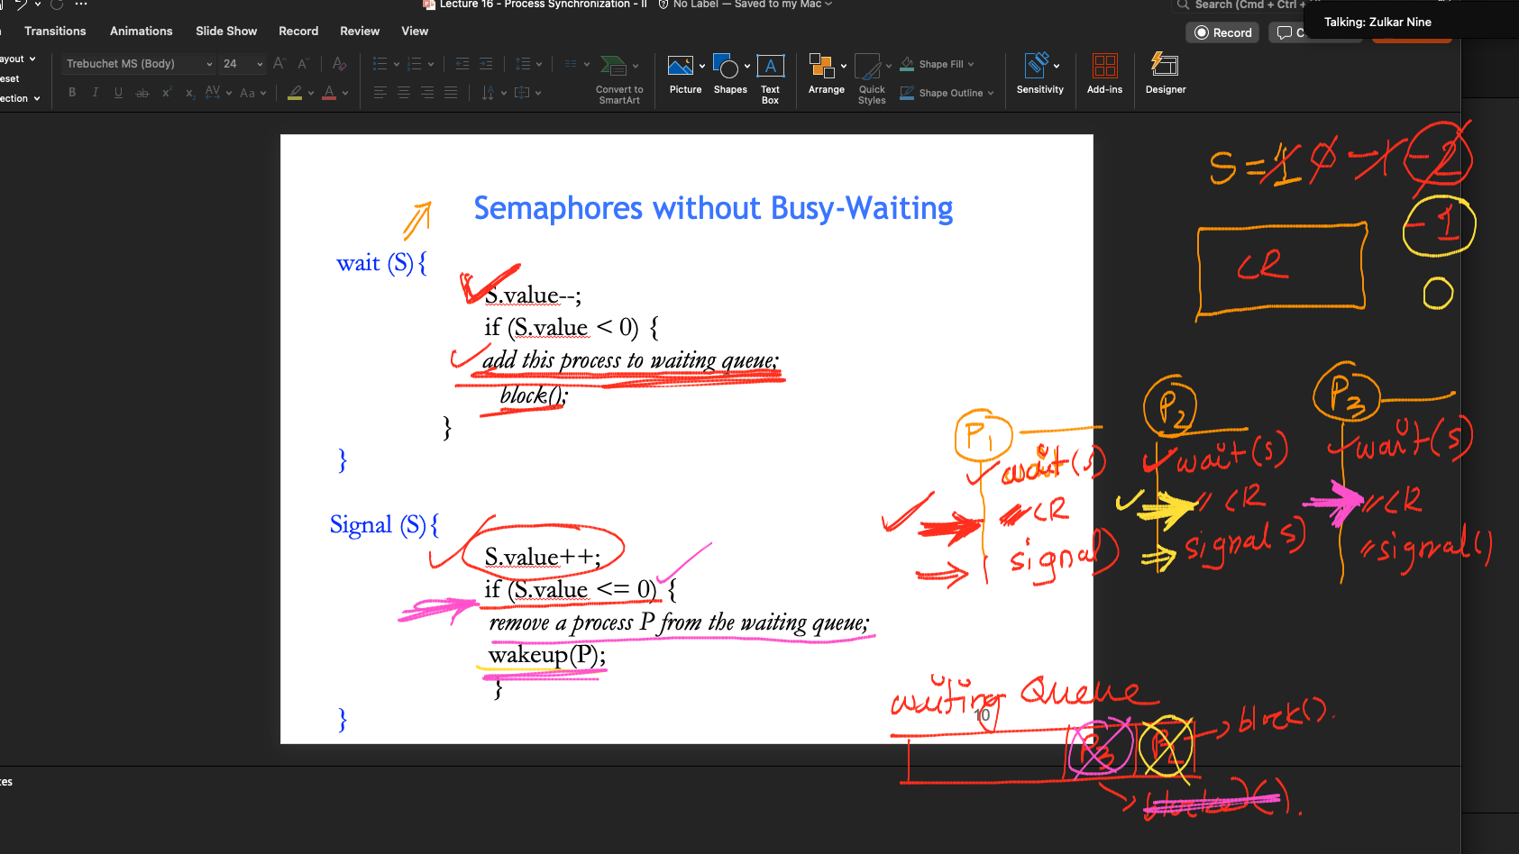
Semaphores without Busy-Waiting
wait (S){
S.value--;
if (S.value < 0) {
add this process to waiting queue;
block();
}
}
Signal (S){
S.value++;
if (S.value <= 0) {
remove a process P from the waiting queue;
wakeup(P);
}
}

Slide 9
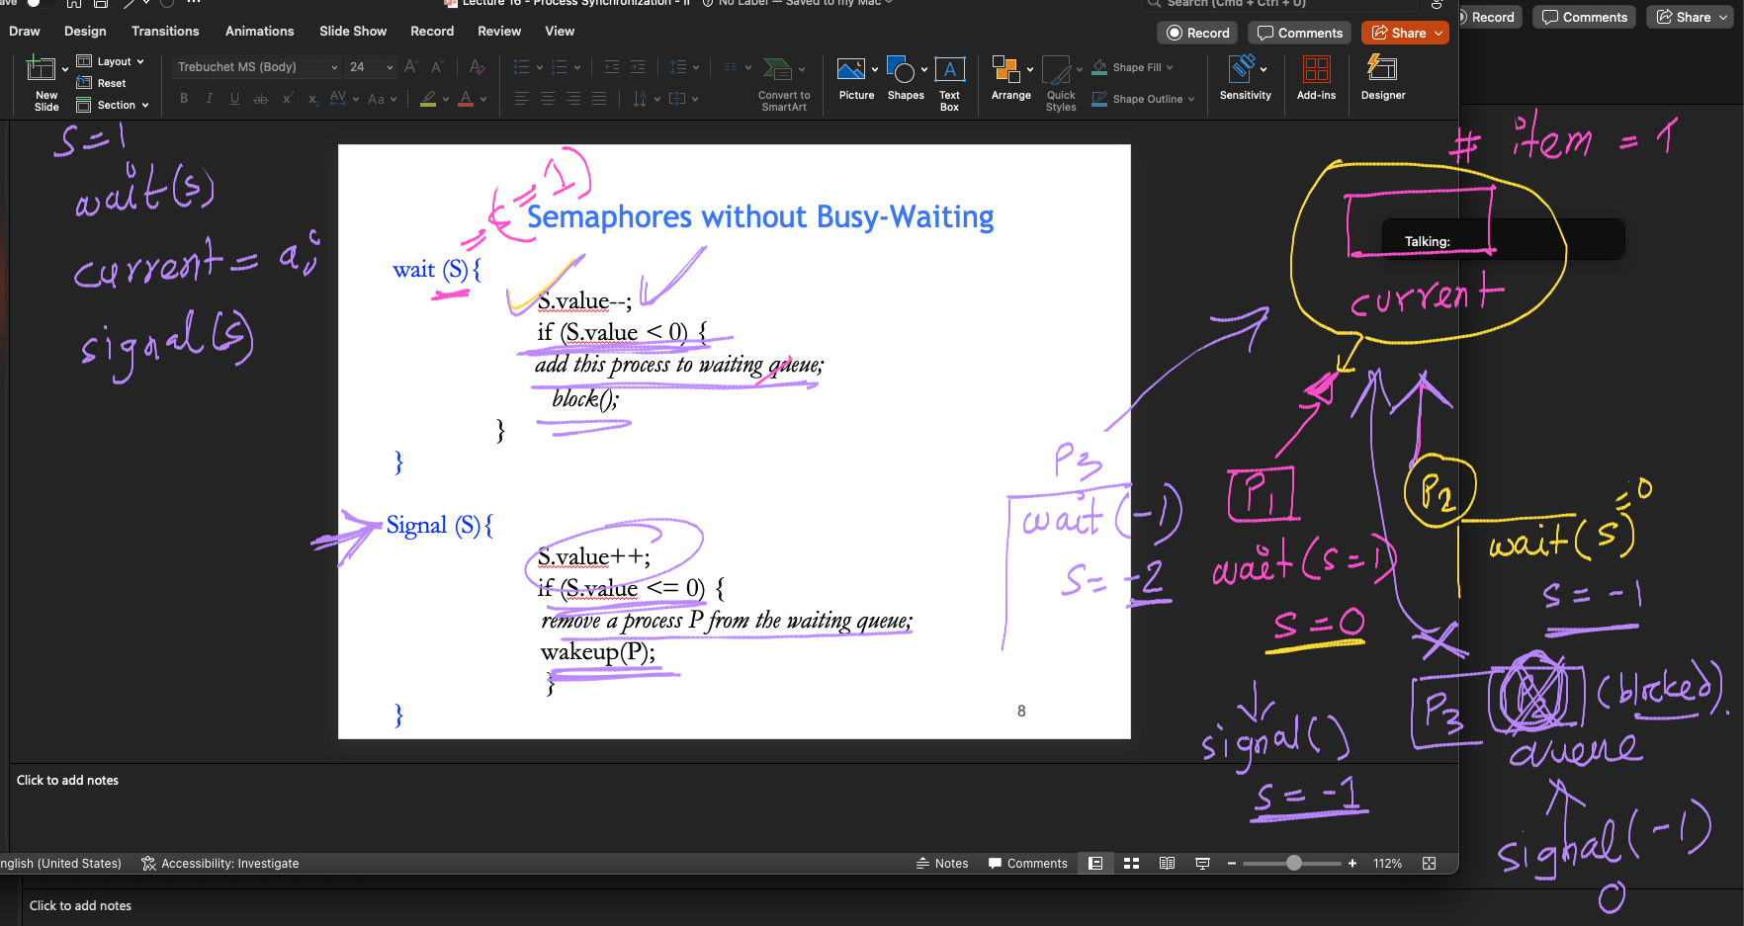

Slide 10
Semaphores as Synchronization Tool
Counting semaphore – integer value can range over an unrestricted domain
Binary semaphore – integer value can range only between 0 and 1; can be simpler to implement
Also known as mutex locks
Provides mutual exclusion
Semaphore S; // initialized to 1
wait (S);
Critical Section
signal (S);

Slide 11
Semaphores without Busy-Waiting
wait (S){
S.value--;
if (S.value < 0) {
add this process to waiting queue;
block();
}
}
Signal (S){
S.value++;
if (S.value <= 0) {
remove a process P from the waiting queue;
wakeup(P);
}
}

Slide 12
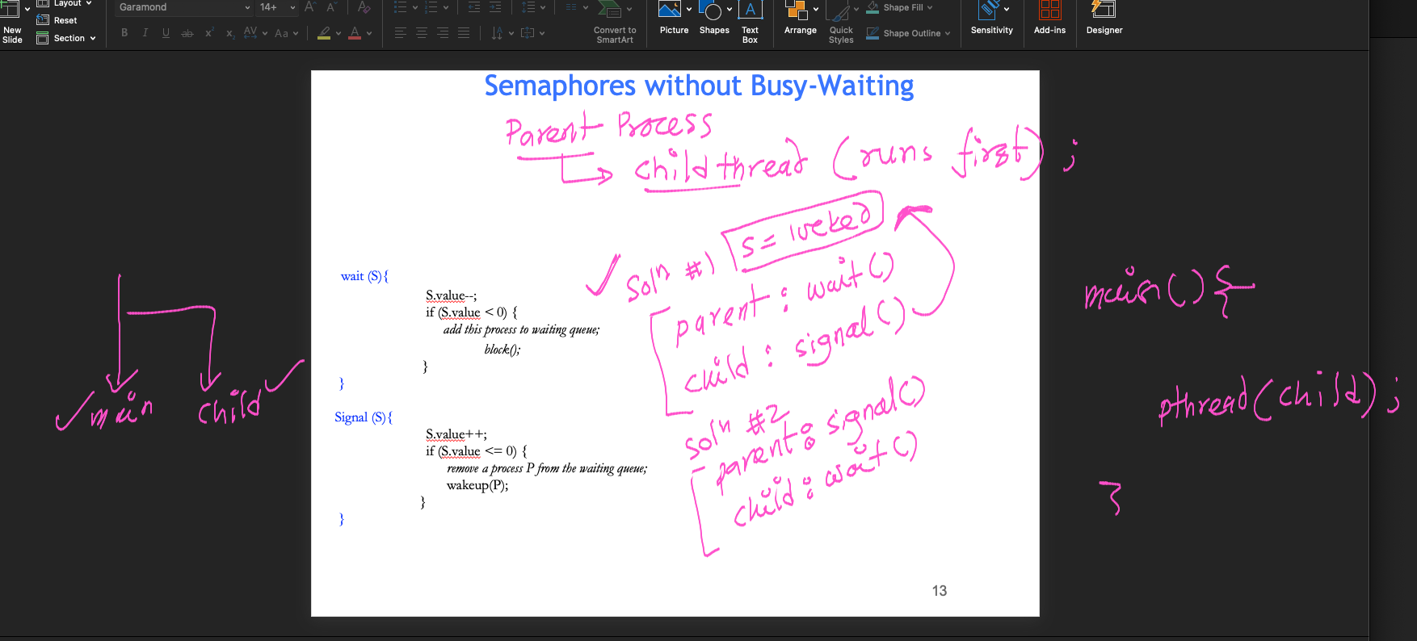

Slide 13
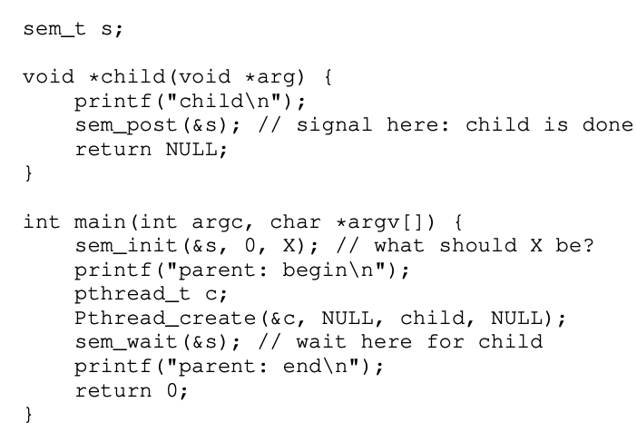
Semaphore for serialization

Slide 14
Classical Problems of Synchronization
Bounded-Buffer Problem
Readers and Writers Problem
Dining-Philosophers Problem

Slide 15
Bounded-Buffer Problem
Shared buffer with N slots to store at most N items
Producer processes data items and puts into the buffer
Consumer gets the data items from the buffer
Variable empty keeps number of empty slots in the butter
Variable full keeps number of full items in the buffer

Slide 16
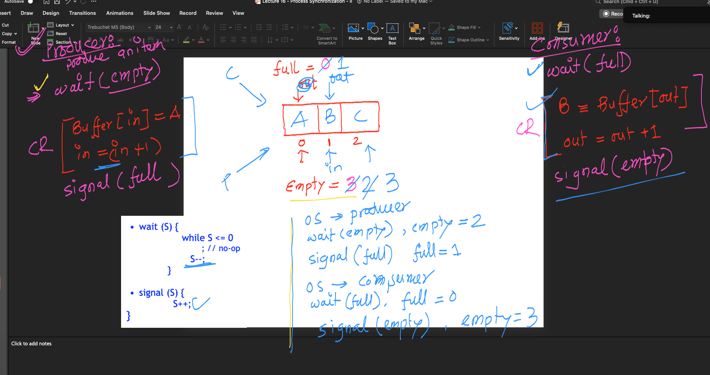
First Attempt to solve Bounded Buffer Problem
It looks like producer and consumer doesn’t enter Critical Region at the same time.
However, is it True for all cases? No

Slide 17
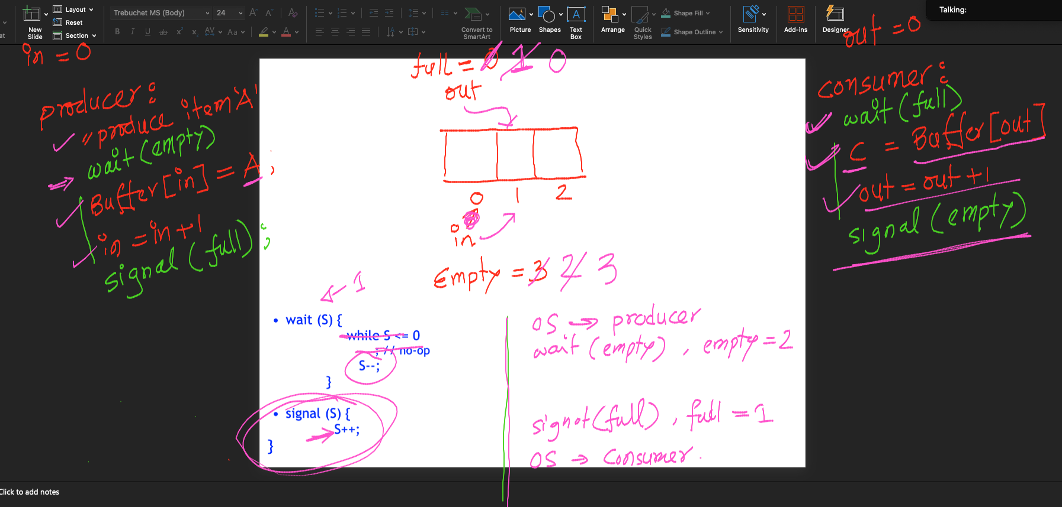
First Attempt to solve Bounded Buffer Problem
It looks like producer and consumer doesn’t enter Critical Region at the same time.
However, is it True for all cases? No

Slide 18
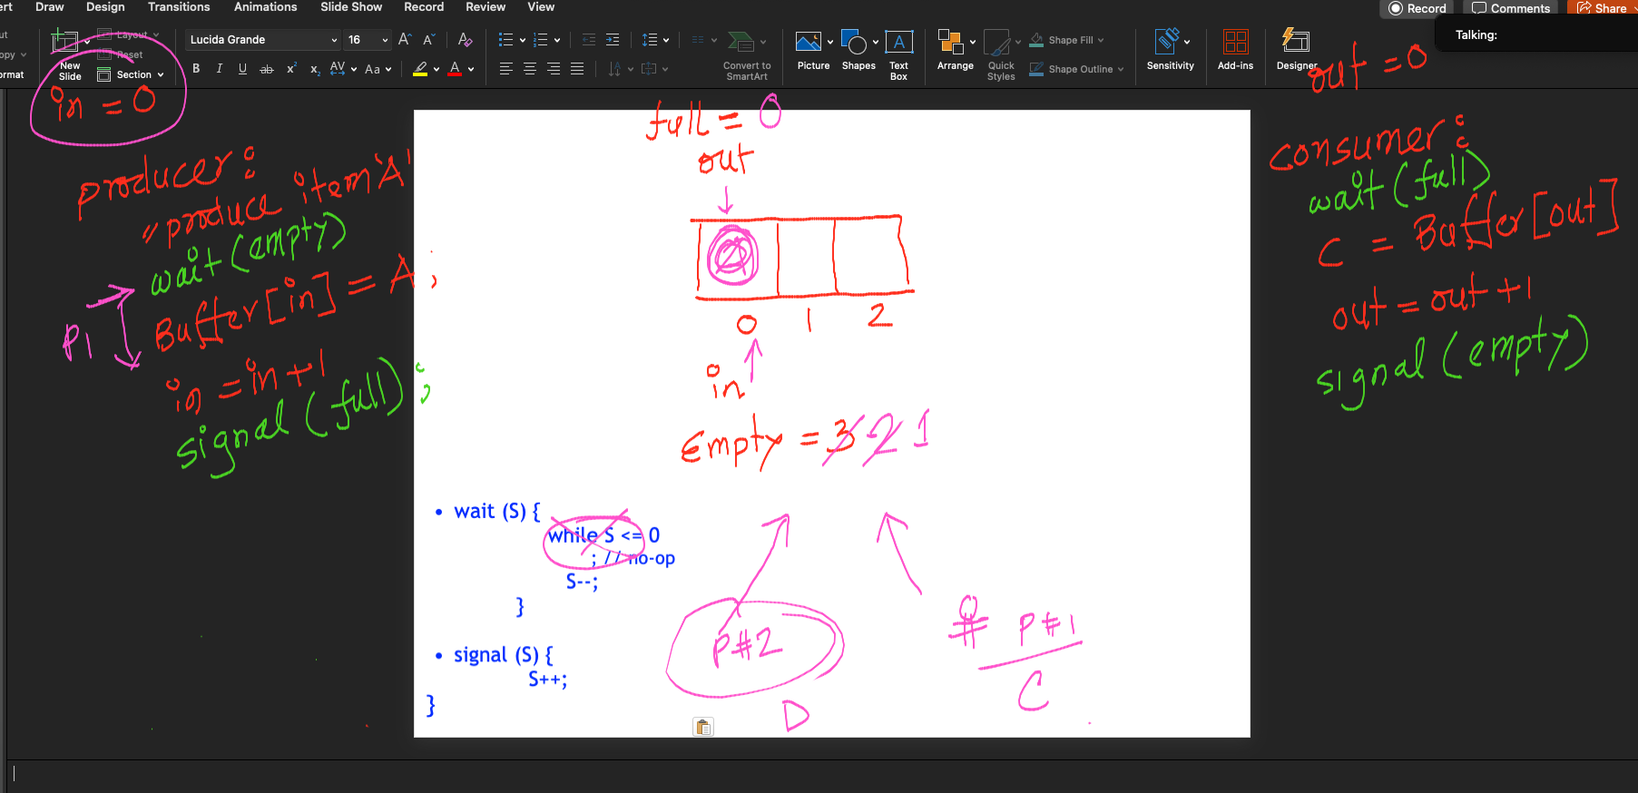
First attempt: Counter Example showing Mutual Exclusion is not protected.

Slide 19
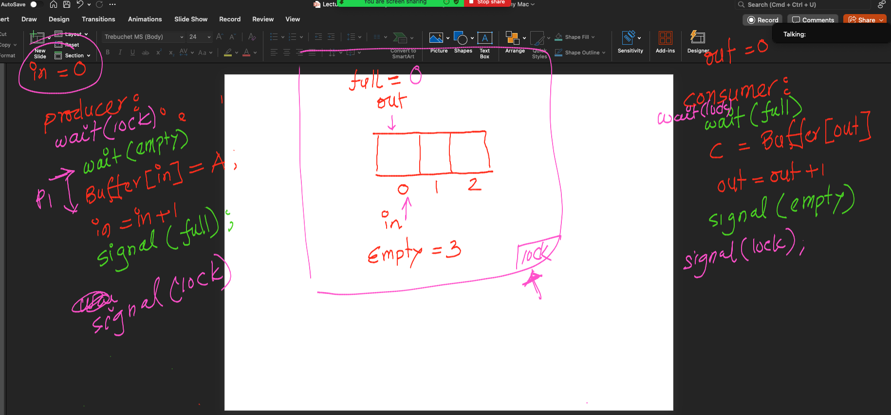
Second attempt: to solve the Bounded Buffer Problem

